Slide 1
Hypermirror to harden Mission critical DWARE reliability

Slide 2
Resources Details – DB(2 nodes RH and 2 nodes RB for RAC)
Server Name | NIC | CPU | RAM (GB) | OS | IP Address | Storage File System Layout
RB-DWHPRD-01 |  | 16 | 32 | Redhat 7.6 |  | / | 40 GB | TIER 3
 |  |  |  |  |  | /tmp | 20 GB | TIER 3
 |  |  |  |  |  | /u01 | 50 GB | TIER 3
 |  |  |  |  |  | /home | 70 GB | TIER 3
 |  |  |  |  |  | /var | 100 GB | TIER 3

Slide 3
HyperMirror enables two identical copies of data to be stored in different storage spaces. If one storage space becomes unavailable, the continuity of data and applications is not affected, improving business reliability
If mission-critical applications require robust business continuity and reliability, HyperMirror can be used with SmartVirtualization to continuously protect data in a heterogeneous storage environment, preventing the failure of a storage system from causing data loss.

Slide 4
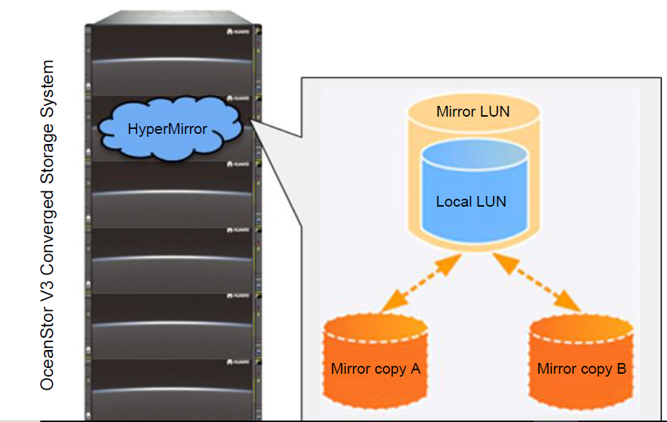
HyperMirror creates a mirror LUN and multiple mirror copies for a LUN (called original
LUN) to prevent the failure of a single LUN from causing service interruption or data loss, thereby improving service reliability.
The normal mirror copy takes over all services from the original LUN, ensuring host service continuity and data integrity.

Slide 5
Steps to implement Hypermirroring
Creating a mirror LUN
Synchronization
Mirror splitting

Slide 6
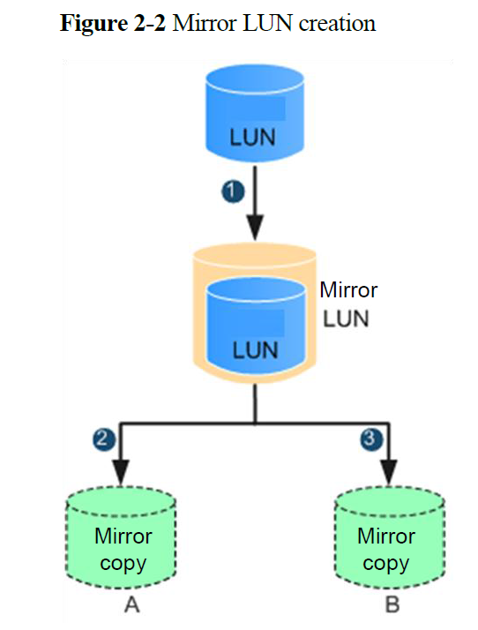
Creating mirror LUN
The original LUN is changed into the mirror LUN, and storage space of the original LUN is handed over to mirror copy A.
Then, mirror copy B is created for the mirror LUN
data is synchronized from mirror copy A to mirror copy B.

Slide 7
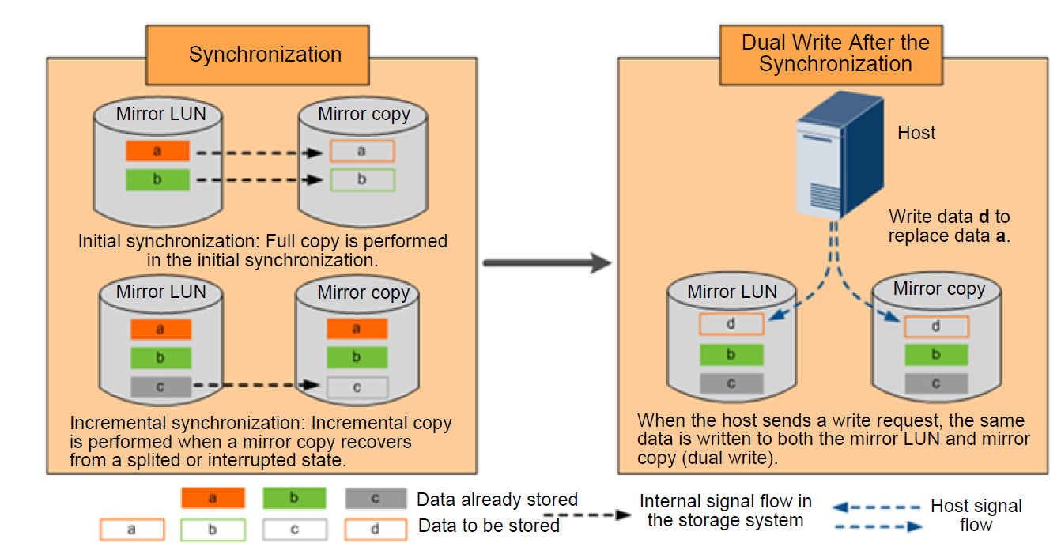
Synchronization
After a mirror copy recovers from a fault or when data on a mirror copy is being made complete, incremental data is synchronized from a complete mirror copy to that mirror copy, making data between mirror copies identical.

Slide 8
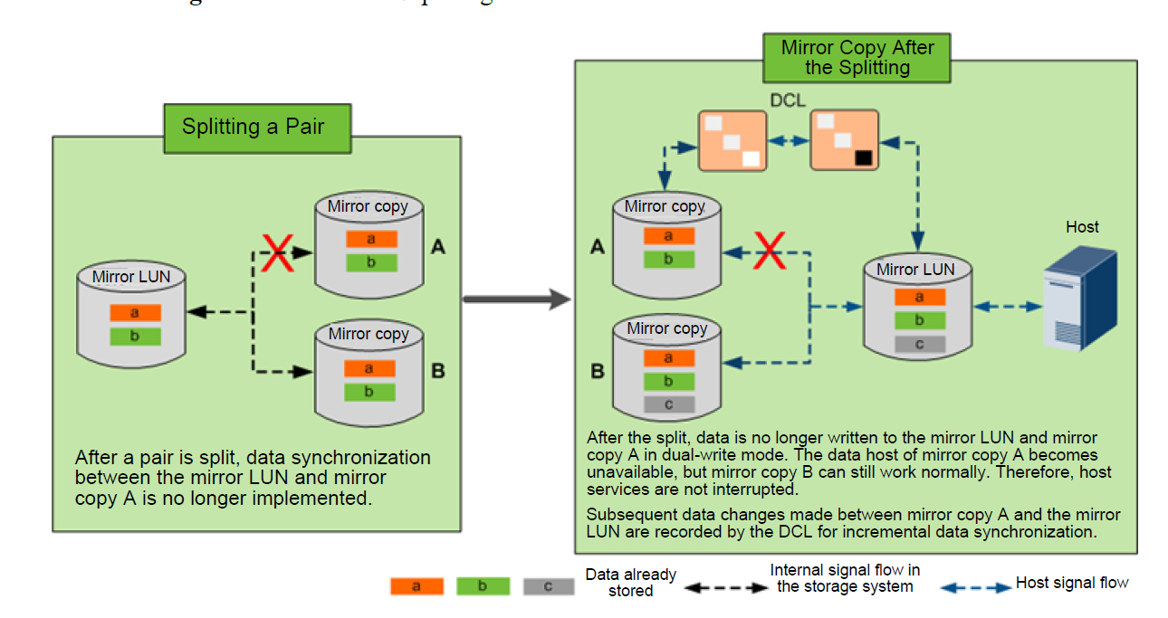
Mirror splitting

Slide 9
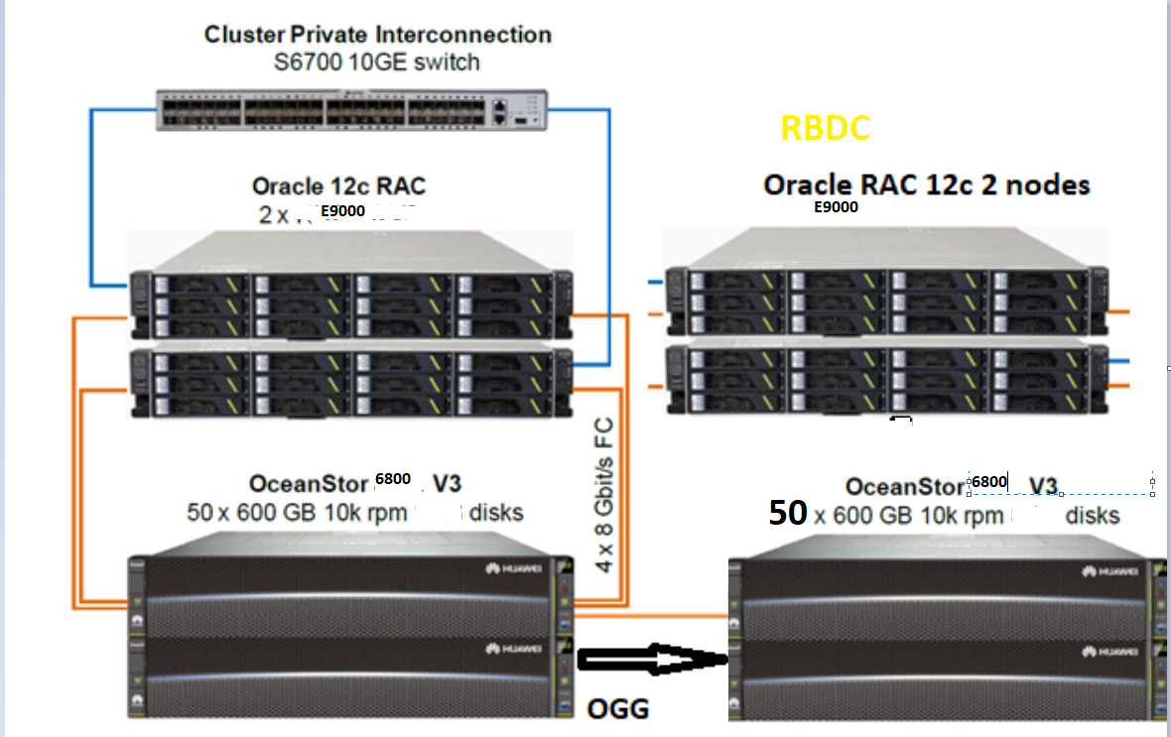
Solution architecture

Slide 10
Oracle Database runs on an OceanStor 6800 V3 converged storage system.
HyperMirror uses different storage spaces provided by the OceanStor 6800 V3 converged storage system to continuously protect Oracle Database and improve data reliability.
SmartVirtualization is used to enable the OceanStor 6800 V3 converged storage system to take over at RBDC.

Slide 11
Stretched RAC cluster
100% uptime, 0% data loss
No idle systems
Instantaneous failover
Wide area protection
Transparent to the application
Excellent performance

Slide 12
Solution configuration
Hardware | Component | Quantity
Server: E9000 |  | 2
 | CPU | 1 x 8
 | Memory | 8 GB x 6
 | QLogic 8 Gbit/s dual-port Fibre Channel HBA | 1 x 2
Storage system: OceanStor 6800 V3(Rose-Hill) |  | 1
 | 600 GB 10k rpm SAS disk 600 GB SSD disks (Dorado) | 35 15
Storage system: OceanStor(Rose-Belle) |  | 1
 | 600 GB 10k rpm SAS disk 600 GB SSD disks (Dorado) | 35 15
Fibre Channel Switch |  | 2

Slide 13
Software configuration
Hardware | Software | Quantity
E9000 |  | 2
 | Operating system: Red Hat Enterprise Linux(Latest version) | 1 x 2
 | Multipathing software: UltraPath for Linux | 1 x 2
 | Database cluster: Oracle Grid 18c | 1 x 2
 | Database software: Oracle Database 18c | 1 x 2
OceanStor 6800 v3 | HyperMirror license | 1 x 1
 | SmartVirtualization license | 1 x 1

Slide 14
Storage plan for the OceanStor 6800 v3(Rose-Hill)
Function | LUN | Storage Pool | Disk Domain
Data volume | 15 x 300 GB | StoragePool1 - RAID 6 (8D+2P) | DiskDomain1 (15 SSD disks)
Data volume | 25 x 500 GB | StoragePool2 - RAID 6 (4D+2P) | DiskDomain2 (25 SAS disks)
Online log volume | 1 x 300 GB | StoragePool1 - RAID 6 (8D+2P) | DiskDomain1 (25 SAS disks)
Archive log volume | 2 x 300 GB | StoragePool1- RAID 6 (8D+2P) | DiskDomain1 (25 SAS disks)
Cluster voting volume | 3 x 5 GB | GridPool - RAID6 (4D+2P) | DiskDomain1 (25 SAS disks)

Slide 15
Storage plan for OceanStor 6800 v3(Rose-Belle)
Function | LUN | Storage Pool | Disk Domain
Data volume | 10 x 300 GB | StoragePool1 - RAID 6 (8D+2P) | DiskDomain1 (15 SSD disks)
Data volume | 25 x 500 GB | StoragePool2 - RAID 6 (4D+2P) | DiskDomain2 (25 SAS disks)
Online log volume | 1 x 300 GB | StoragePool1 - RAID 6 (8D+2P) | DiskDomain1 (25 SAS disks)
Archive log volume | 2 x 300 GB | StoragePool1- RAID 6 (8D+2P) | DiskDomain1 (25 SAS disks)
Cluster voting volume | 3 x 5 GB | GridPool - RAID6 (4D+2P) | DiskDomain1 (25 SAS disks)

Slide 16
Notes
Create two disk domains, each of which consists of 25 x 600 GB disks.
In DiskDomain1, create GridPool and StoragePool1.
GridPool is used to create cluster voting volumes for Oracle RAC.
StoragePool1 is used to create data volumes, online log volumes, and archive log volumes related to the database.
In DiskDomain2, create StoragePool2 that is used to create data volumes related to archive data(>18 months) in the database.
The remaining space is used to create mirror copies for data volumes in the storage pools.

Slide 17
Preparing the environments
Prepare a physical environment.
Deploy a test environment based on the solution architecture shown in
Install and configure the operating system on each host.
Prepare storage devices.
Based on the plan, configure a SAN switch, create an alias, and set zones.
Based on the plan, configure storage, create host groups and hosts, and map LUNs.
Install UltraPath.
Upload the UltraPath software package, which is used with the OceanStor 6800 V3 converged storage system, to database nodes.
Configure a UDEV policy.
On database nodes, configure a UDEV policy for LUNs
Install Oracle Database
Deploy an Oracle cluster and install Oracle Database in the OceanStor 6800 V3 storage
system.

